Slide 1


PROJECT PROPOSAL
PROBLEM STATEMENT
PROPOSED SOLUTION
PROJECT TIMELINE
WHAT’S NEXT
SUMMARY
INDERPREET SINGH PARMAR . FAHAD ALI KHAN

Slide 2

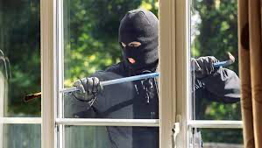
Problem statement
Addressing Residential Security Challenges
Rising Concerns The growing rate of residential security breaches has highlighted the need for advanced, reliable security solutions.
Families feeling threatened Those families living in high-risk living areas, or those feeling vulnerable due to previous incidents

Slide 3

Proposed solution
Utilizing the FRDM K66 microcontroller, the system features a proximity sensor, camera, keypad, speaker, and LCD screen, designed to detect, identify, and grant access with real-time responsiveness.

Slide 4
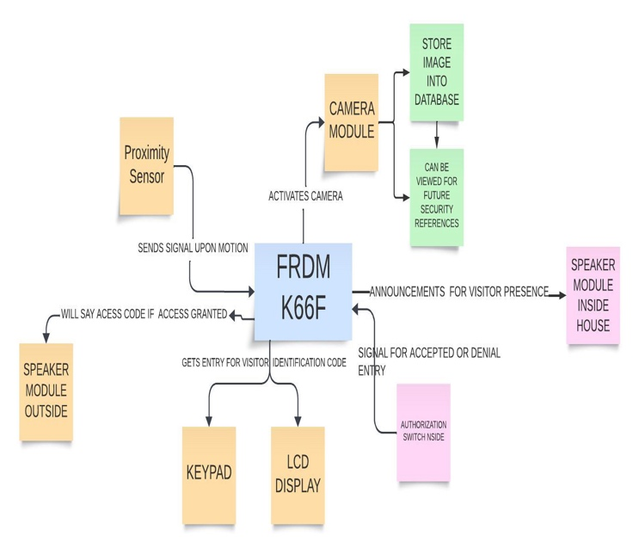
Components and their functions at door
FRDM K66F
PROXIMITY SENSOR MODULE
CAMERA MODULE
LCD DISPLAY MODULE
SPEAKER MODULE
KEYPAD

Slide 5
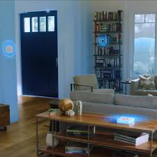
Components and their functions inside the residence
SPEAKER MODULE
AUTHORIZATION SWITCH MODULE

Slide 6

Project timeline
OUR PROJECT WILL UNFOLD OVER 5 WEEKS
BOTH TEAM MEMBERS WILL DEDICATE 8 HOURS EACH WEEK
80 HOURS IN TOTAL

Slide 7
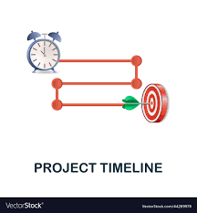
PROJECT TIMELINE
Our timeline is structured to include phases of design, development, testing, and final implementation, ensuring a systematic approach to completing our security system project within the designated time frame.

Slide 8

WHAT’S NEXT
PROCURING COMPONENTS AND SETTING UP DEVELOPMENT ENVIRONMENT
DEVELOPMENT PHASE
TESTING AND VALIDATION
USER FEEDBACK AND ITERATION
FUTURE ENHANCEMENTS – FACE RECOGNITION, NLP AND VOICE RECOGNITION

Slide 9
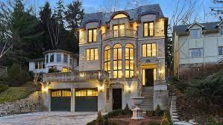
SUMMARY
FULFILLING
FULFILLING SECURITY NEEDS FOR VULNEARBLE FAMILIES DUE TO HEIGHTENED SECURITY RISKS
UTILIZING
UTILIZING THE FRDM K66F MICROCONTROLLER, PROXIMITY SENSOR, CAMERA, KEYPAD, SPEAKER, LCD SCREEN AND AUTHORIZATION SWITCHES

